Slide 1

Presentation to the
Juvenile Justice Coordinating Council
May 23, 2011
Thomas Abt, Office of Justice Programs, DOJ

Slide 2
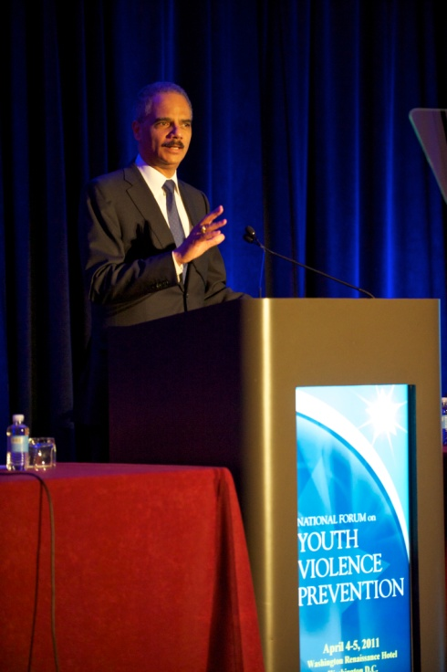
“Above all, let us lift up six American cities as examples of what it means to break down traditional barriers and find creative solutions to our most critical problems. Then let us broaden our efforts by sharing the lessons we learn with other communities across the country. Let us remake our nation.”
– Attorney General Eric J. Holder

Slide 3
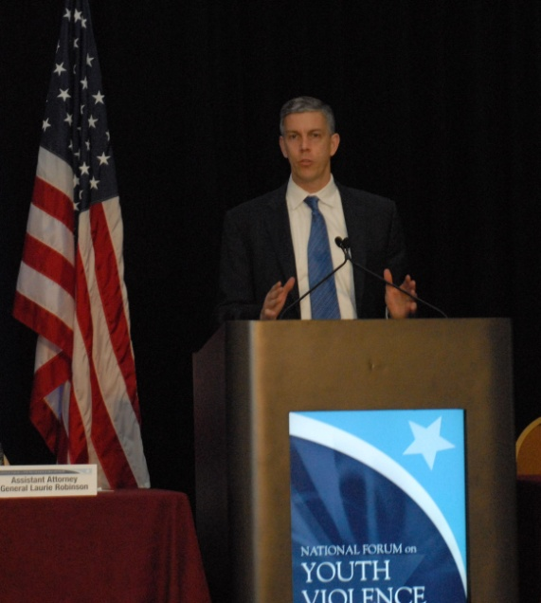
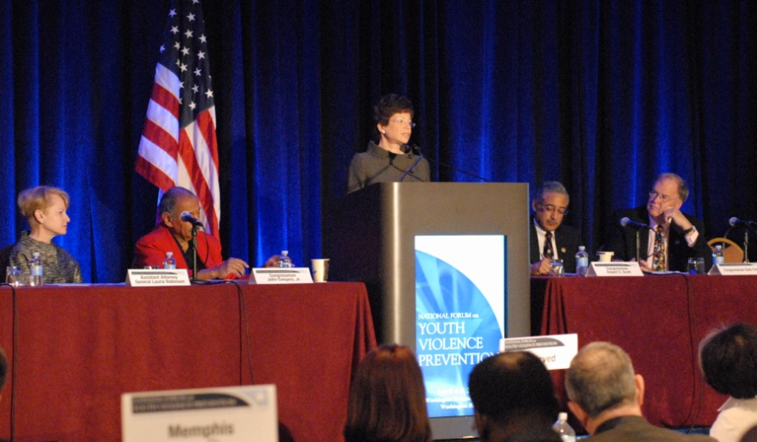
  "This forum is an opportunity to better learn how we can provide the tools and resources that communities, administrators, teachers, parents and students need to keep our children safe.“
  – Secretary Arne Duncan
“By linking cities and federal agencies to one another, the National Forum on Youth Violence Prevention is sending a powerful message… ‘You are not alone. We are all in this together.’”
– Senior Advisor to the President, Valerie Jarrett

Slide 4
About the Forum
Network of agencies and localities who
  share information
  offer technical assistance
  coordinate action and resources
  profile successes
Diversity at federal and local levels
  DOJ, ED, HHS, Labor, HUD, ONDCP
  Boston, Chicago, Detroit, Memphis, Salinas, San Jose
  local teams include diverse mix of stakeholders

Slide 5
More About the Forum
Each locality prepares and implements a comprehensive youth violence plan featuring:
  Multi-disciplinary partnerships
  Balanced Approaches
  Data-driven strategies
Federal agencies support plans with information, technical assistance, training, and coordination
Forum is about using current funding better through collaboration and effective use of evidence and data

Slide 6
Forum Goals
Short term: preparation of plans leads to more partnerships, improved coordination of resources, and better use of data
Medium term: favorable exposure of plans leads to increased support and improved ability to secure funding
Long term: implementation of plans should eventually
  Reduce youth violence
  Improve opportunities for youth development
  Encourage innovation and better coordination of funding, policy, and regulation

Slide 7
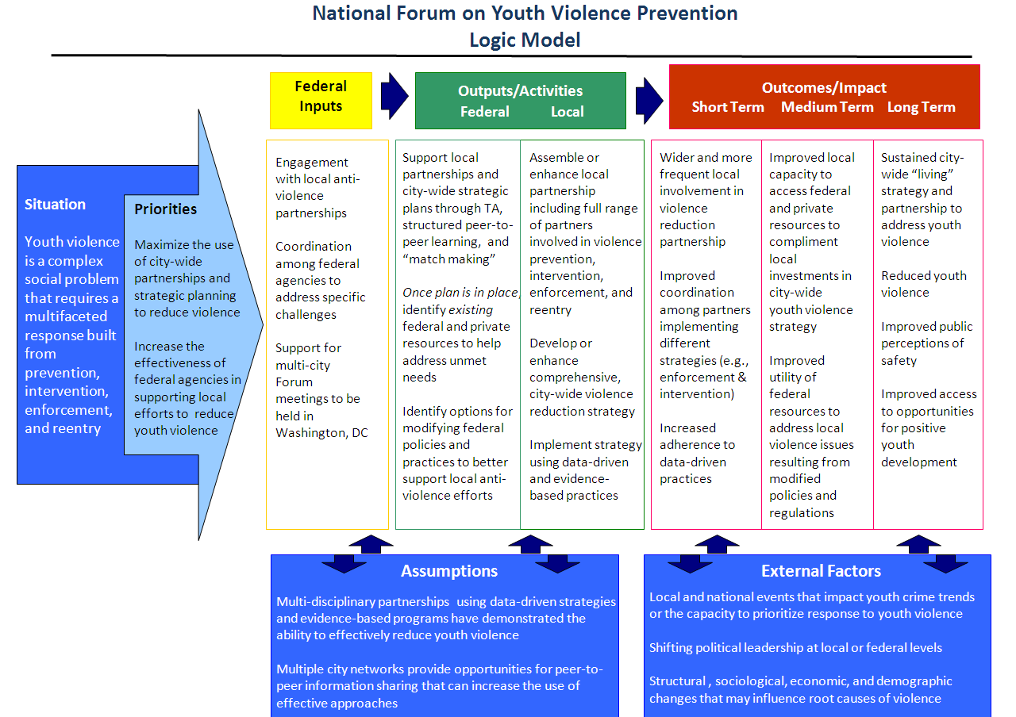

Slide 8
The Forum So Far
Fall 2009
Spring/Summer 2010
October 2010
April 2011
Planning begins
Listening sessions take
place in each city
Working Session held in Washington, D.C.
National Summit convened in Washington, D.C.

Slide 9
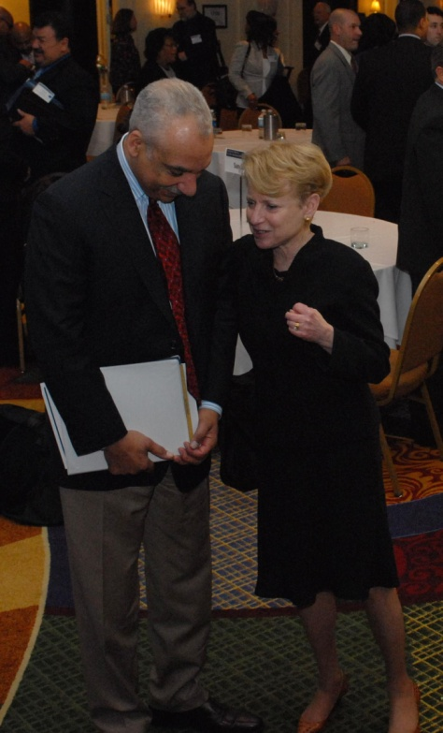
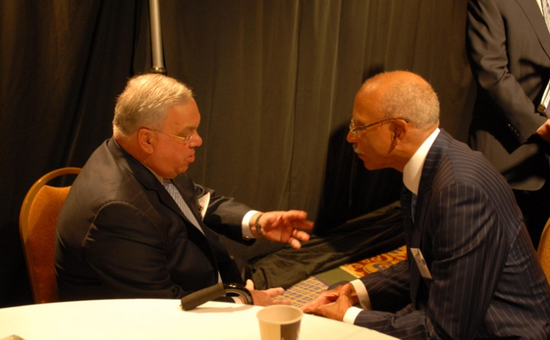
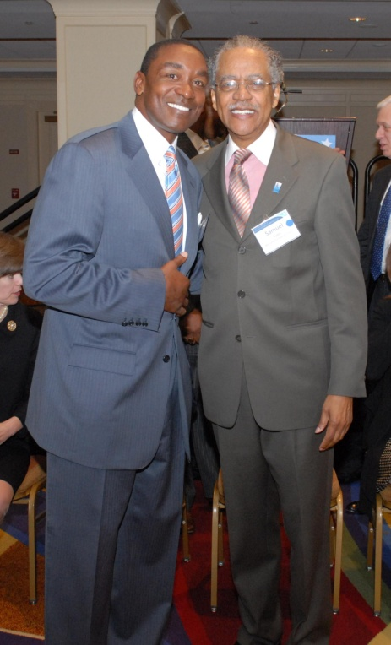
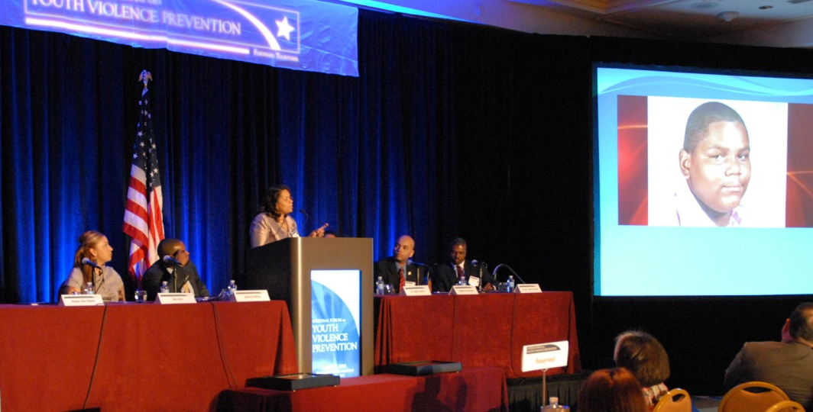
The Summit – great speakers, energy and emotion

Slide 10

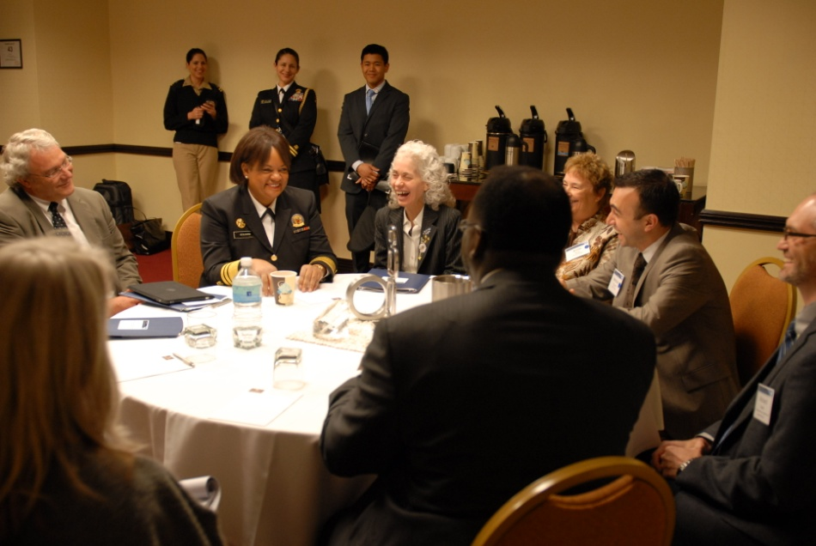
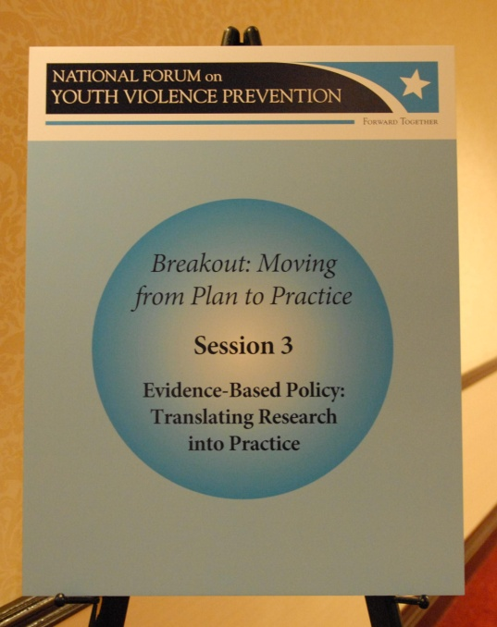
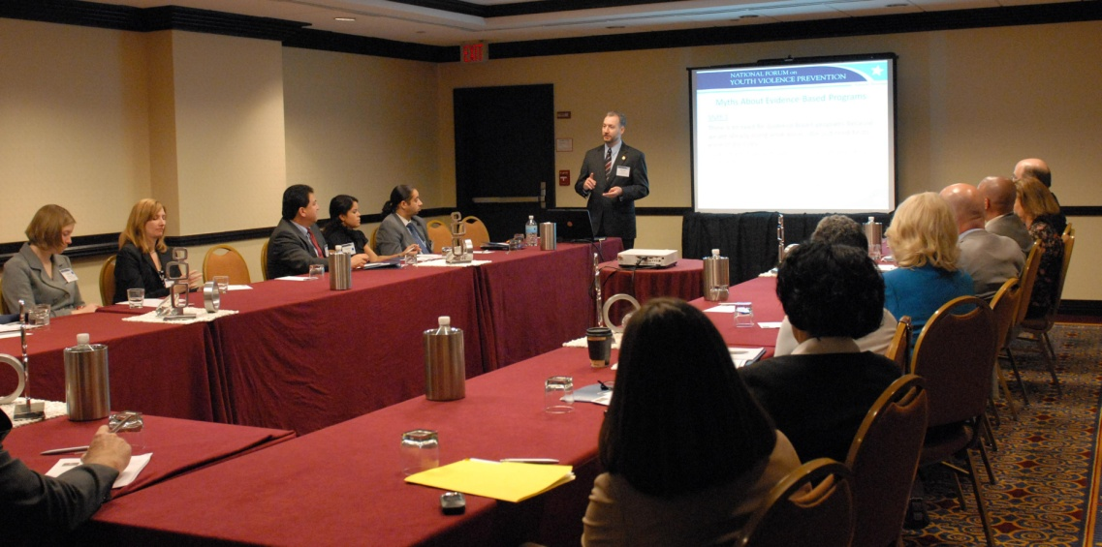
The Summit – useful breakout sessions

Slide 11


The Summit – positive media coverage
San Jose participating in national summit on preventing youth violence
Big stage for Salinas’ anti-gang plan
Bing, Detroit officials tout youth initiative in D.C.
Memphis touted as national leader for strategies to cut youth violence
Menino proposal aims to fight youth violence

Slide 12
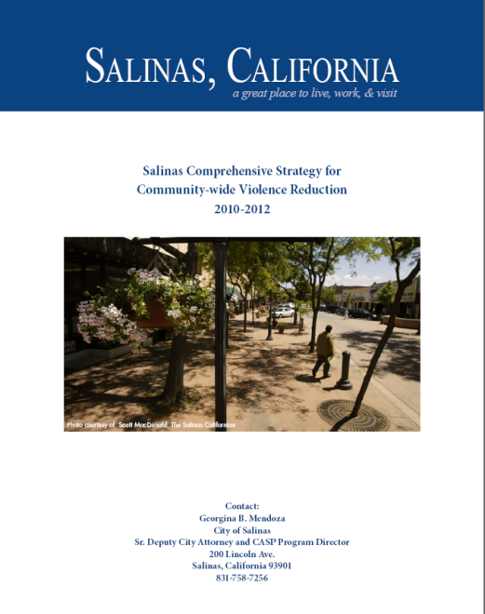





The Plans – robust, delivered in short timeframe

Slide 13

The Website www.findyouthinfo.gov/youthviolence

Slide 14
The Future of the Forum – Continuing the Conversation, Adding Your Voice
Current focus is on plan implementation, with plans to add new cities in FY 2012 (pending appropriation)
Need to expand conversation – adding new voices, engaging additional stakeholders and thought leaders
Look to broaden and deepen federal participation, coordinate with other groups like JJCC
More next steps? You tell us!
The Forum is yours – use it!

Slide 15
Agency Contacts
DOJ: Thomas Abt, Thomas.Abt@usdoj.gov
ED: Norris Dickard, Norris.Dickard@ed.gov
HHS: Martha Moorehouse, Martha.Moorehouse@hhs.gov
CDC: Corinne Ferdon, CFerdon@cdc.gov
Labor: Edna Primrose, Primrose.Edna@dol.gov
HUD: Dan Lurie, Daniel.B.Lurie@hud.gov
ONDCP: Patrick Schmidt, Patrick_R._Schmidt@ondcp.eop.gov
Don’t forget to check us out at www.findyouthinfo.gov!

