Slide 1

Liberty LEADS is guided by the principle that all children have gifts, talents, and great potential and can contribute to one another's social and academic growth.

Slide 2
Overview
Liberty LEADS serves over 320 students from 5th through 12th grade.
All students have access to a wide range of:
      Academic Enrichment
      Leadership Development
      College Prep Classes
      Cultural Enrichment
      Counseling & Mentoring Activities
All students are prepared for admission to college or meaningful employment.

Slide 3
Need
Every school day, 7,000 American high school students become dropouts. (Pinkus, 2006)
60% of NYC public school students graduate on time.
Fewer than 50% of male students graduate high school on time
Fewer than 50% of African American and Latino students graduate on time.
63% of NYC public school students report that they plan to attend college after graduation.
37% of NYC public school students in 11th and 12th graders take the SAT.
(Data from NYC DOE)

Slide 4
National Need
On March 2, 2010, President Barack Obama highlighted stronger federal efforts to help lower a high school dropout rate that, according to the president, is “undermining America's future economic potential”. . .According to the White House, roughly 1.2 million students drop out of school every year, about half of whom are Latino or African-American. As a consequence, the administration claims, the country loses almost $320 billion in potential earnings every year.
Since over a million students fail to graduate each year, this loss is repeated annually. (Pinkus, 2006)
A high school dropout earns, on average, about $260,000 less than a high school graduate and about $1 million less than a college graduate. (Pinkus, 2006)
A 5% increase in the male high school graduation rate would save approximately $4.9 billion in related crime costs each year. (Pinkus, 2006)

Slide 5
Liberty Students
64 % Latino, 23% African American,7 % Multiracial, 5 % Asian, 1 % White
53 % Males, 47 % Females
50 % come from single parents households.
42 % have experience a negative change in their lives between 2009-2010.
43 % are struggling with emotional stress, caused by factors such as depression, loss of parents, incarceration of parents, domestic violence and/or exposure to drug abuse.
30 % come from household with limited English proficiency .
20 % come from homes where either a parent or sibling has not finished high school.
18 % receiving special education services.

Slide 6
Program Design
Academic Advisement Model
  One on one meetings with students, parents and school personnel
  Tracking academic performance
  Middle School and High School Cohorts
Psycho-Social Model
  Intake meetings
  Individual and group counseling
  Family sessions
  Crisis intervention
  Case Management
Leadership Retreats
  Community service activities and exposure to different facets of leadership
Adventure Based Counseling
  Gender based counseling groups
  All male summer wilderness retention program
  Middle School summer leadership/retention program
Data and Evaluation

Slide 7
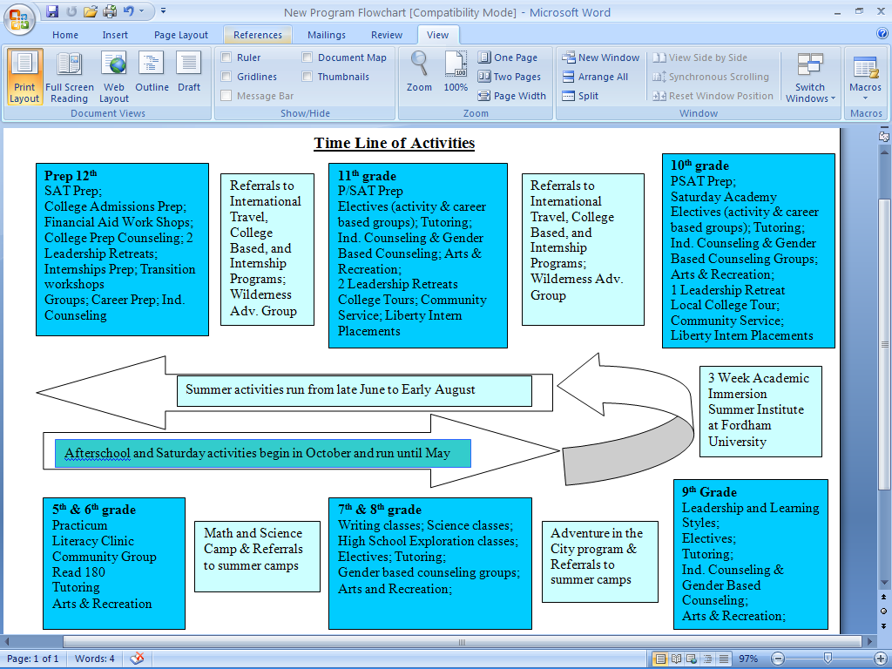
Timeline of Activities

Slide 8
Case Study I
Reasons for referral
  Behavior issues at home and at school, several suspension (2 per year)
  Academic struggles and learning disability
  Low SES
  Family history of not completing school
LLP Interventions
  Academic support
  Individual counseling
  One on one meetings
  Filmmaking project
  Parent and School visits
LLP Results
  Significant improvement in grades
  No suspensions the past 2 year
  Less aggressive with staff and peers
  Leader in program

Slide 9
Case Study II
Reasons for Referral
  Behavior issues at home and at school, several suspension (over 6)
  Violent behavior with 2 arrests for violence
  Verbal and physical conflict in the home
  Academic struggles, attended 3 high schools
  Low SES
LLP Interventions
  Crisis interventions Individual and Family counseling and therapeutic referrals
  Academic support
  Parent and school visits
  Summer programming and employment
LLP Results
  High School graduate
  Attending City College
  Fully Employed

Slide 10
Results
Liberty LEADS has been serving a diverse group of students for over 22 years.
One hundred percent of students who apply to college are admitted.
Over 94% percent of students graduate high school on time.
Over 98% of our students are promoted each year.
Due in large part to our Adventure Based Counseling Program we have increased our male retention rate from 40% to 85%.
Our overall program retention rate has been over 92% for the past three years.
Liberty LEADS students have traveled abroad to all seven continents (including Antarctica).

Slide 11
In Their own Words
“I don’t see the advisors at Liberty like I see teachers in my school but more like family. I come here because I want to come here.”
“The most valuable lesson I have learned from the program is to work hard and don’t let anybody hold you back from your own success. To this day, program administrators are very encouraging and want to see you be successful. “
“If Liberty were not an intricate part of my life, I would probably not have made it through college, high school or even junior high school. It was the very act of intervention, and the nurturing support that continued to focus and refocus my vision towards the distant horizon. When I faced road blocks, they showed me the entirety of the road. When I was ready to give up they mapped out solutions. When I was in despair, they hugged me. Now in turn, I have a life-long commitment to similar students in need. “
www.bankstreet.edu/libertyleads

