Slide 1


Salinas, California
Addressing the Roots of Violence Through a Collective Impact Approach

Slide 2
What is CASP?
A Cross Sector Collective Impact and
Networking Organization
To build stronger relationships across sectors
To learn and disseminate best practices
Align work across organizations to maximize impact
Create and implement a strategic plan on violence reduction
Monitor and share indicators linked to our plan
Notes:
Three locations based on police crime data
Del Monte (Between Sanborn & Williams)
Hebbron Heights
Acosta Plaza
Three Guiding Principals
Build Relationships
Establish Visibility through Consistency
Connect with as many people as possible
Bi-monthly Meetings pulling together CBO, Education, County and Community leaders

Slide 3
Four Operating Principals of CASP
A single operational structure manages action and progress.
Action is research and data-driven.
The youth are at the center.
There is deep and meaningful engagement with the community.
Notes:
The Salinas Comprehensive Strategy for Community-wide Violence Reduction presents the details of our strategies to reduce and prevent gang and youth violence and is based on four key principles:

Slide 4
Professional Learning Communities:
Policy and Best Practices
National: National Forum on youth Violence Prevention
State: California Cities Violence Prevention Network
Local: Partners with STRYVE operated out of the County Health department
Regional:
  Local Law Enforcement
  4C4P,
  Blue Ribbon Panel,
  City of San Jose Mayor’s Gang Task Force,
  County Gang Prevention Coordinator

Slide 5
CASP History
In March 2008, the Children’s Council of Monterey County established the Violence Prevention (VP) Subcommittee.
The VP Subcommittee met regularly since April 2008 and focused specifically on ways to reduce gang violence.
Also in 2008 then Salinas Mayor created the Community Safety Alliance.
In late November, 2008, members agreed to formally join with the Community Safety Alliance of the city of Salinas to further unify efforts to promote peace and safety under the name of Community Alliance for Safety and Peace.
  Shortly after the Community Safety Division was created and was charged with staffing CASP.

Slide 6



Key Partner Initiatives
Strategic Plan
Funding
Networking
  Shared learning
  Creating relationships across cities
Technical Assistance
  Sustainability
  Faith Community
  Resource development
Goal: To prevent youth violence in Salinas, using a public health approach.
Project Outcomes: ↑ capacity of Health Department and Coalition (CASP) to prevent youth violence
Process: Identify risk/protective factors, develop a comprehensive plan, implement evidence based strategies, evaluate and create a sustainability plan.

Slide 7
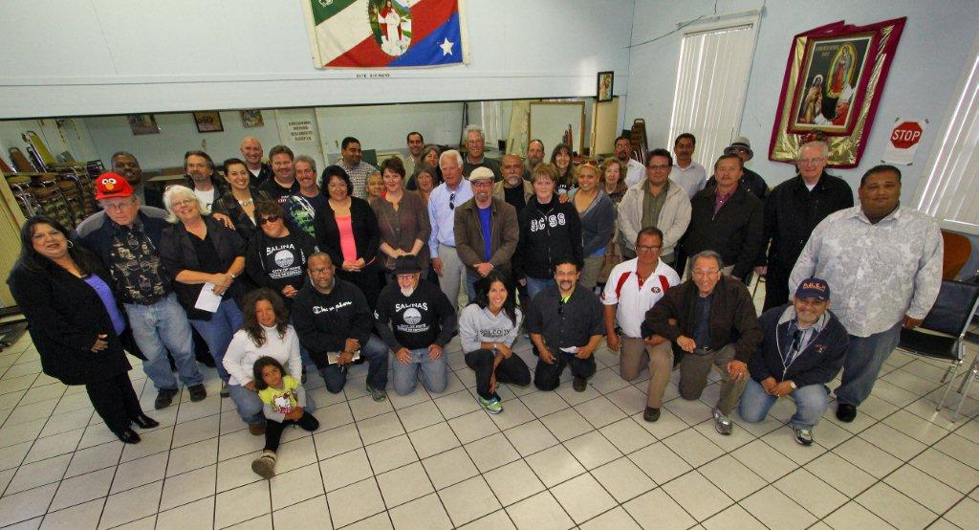
Salinas Night Walks

Slide 8
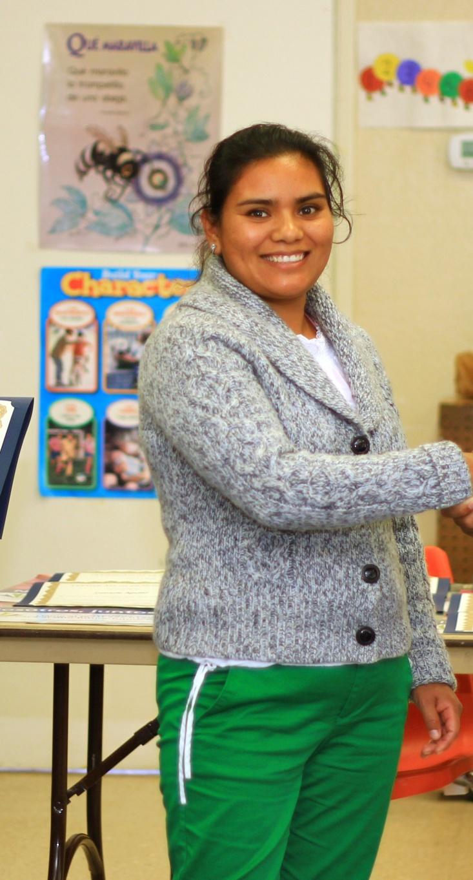
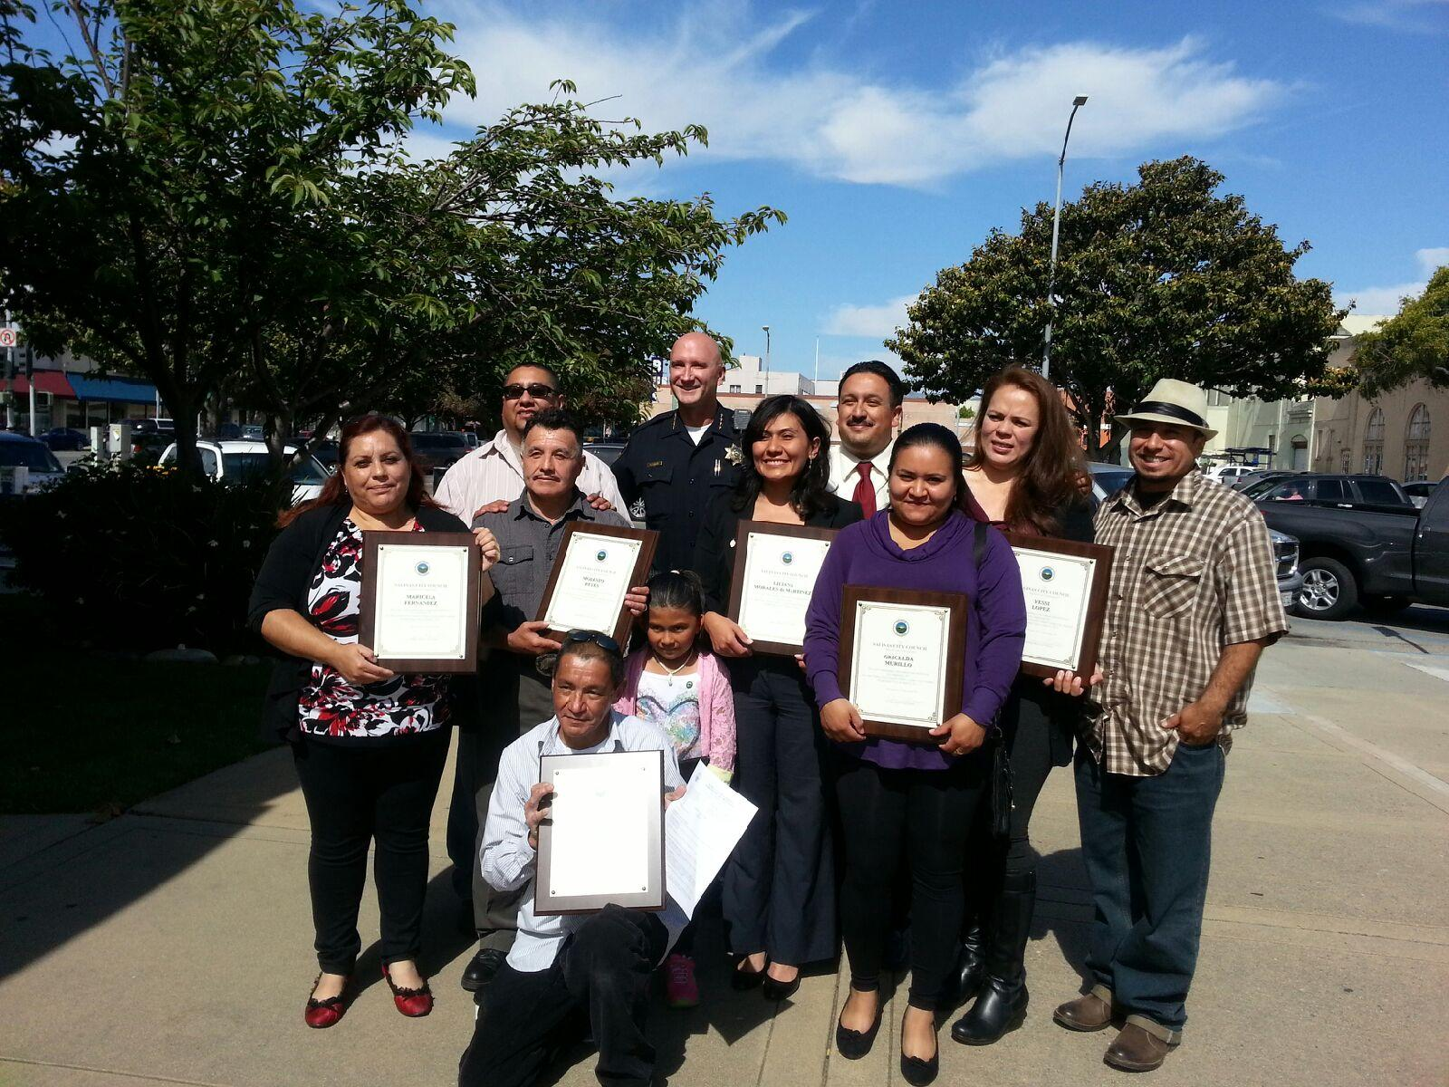
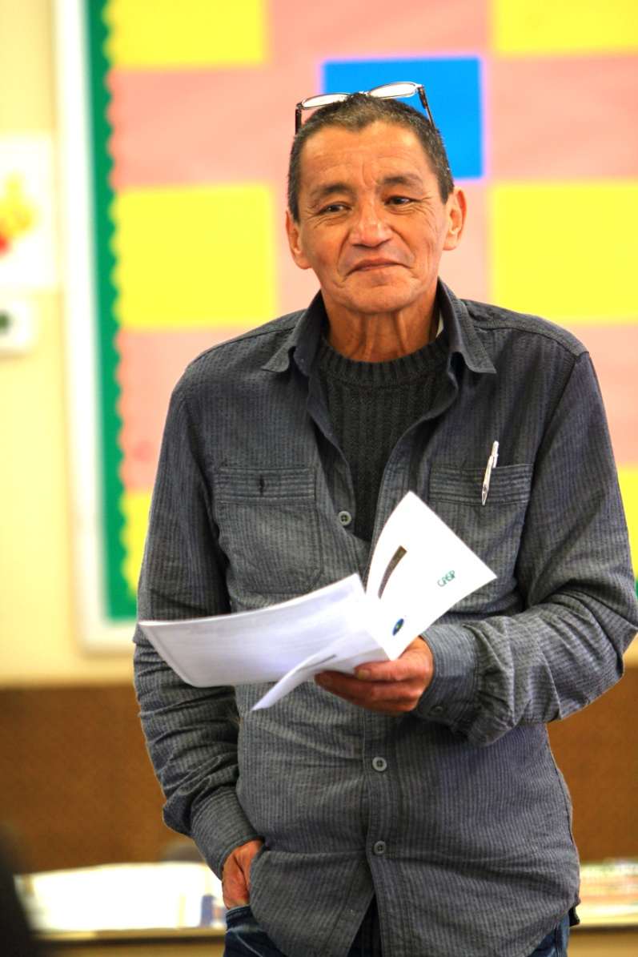
Community Leadership Academies

Slide 9
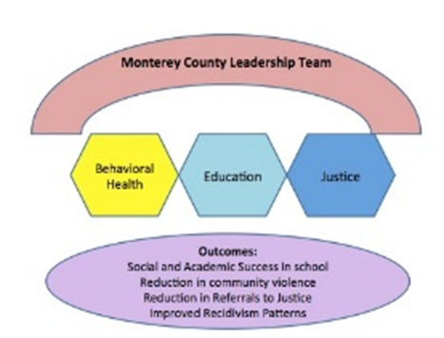
Key Partner Initiatives
School Climate Leadership Team
Preventing Youth Violence through PBIS An Interagency Eﬀort to Transform Schools and Communities
Funded by the Department of Education, the Oﬃce of Juvenile Justice Delinquency Prevention Program and Substance Abuse Mental Health Administration
My Brother’s Keeper Initiative
A summit is planned for March 2016
The summit will be co-hosted by
  The City of Salinas
  Building Healthy Communities
  MILPA
  County of Monterey

Slide 10
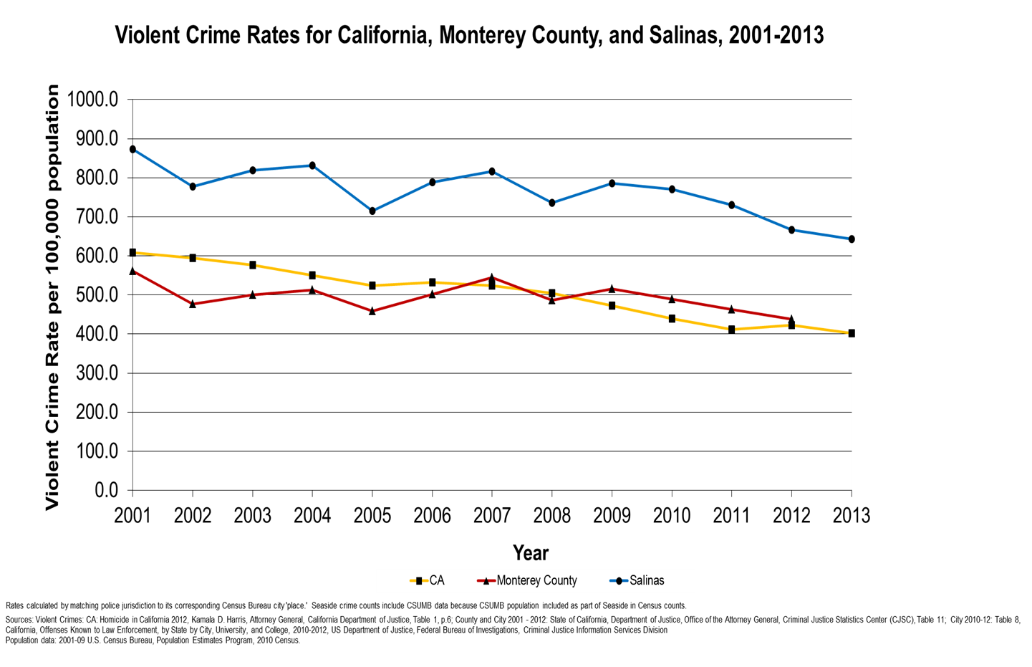

Slide 11


www.future-futuro.org
  Jose Arreola
Community Safety Division Administrator
& CASP Director:
  jose.arreola@ci.salinas.ca.us
  (831) 758-7396

