Slide 1




Slide 2

www.nationalgirlsinstitute.org
Notes:
NGI Purpose
To advance the understanding and application of promising and evidence-based prevention, intervention, treatment, and aftercare programs and services for girls involved or at risk of system involvement.

Slide 3
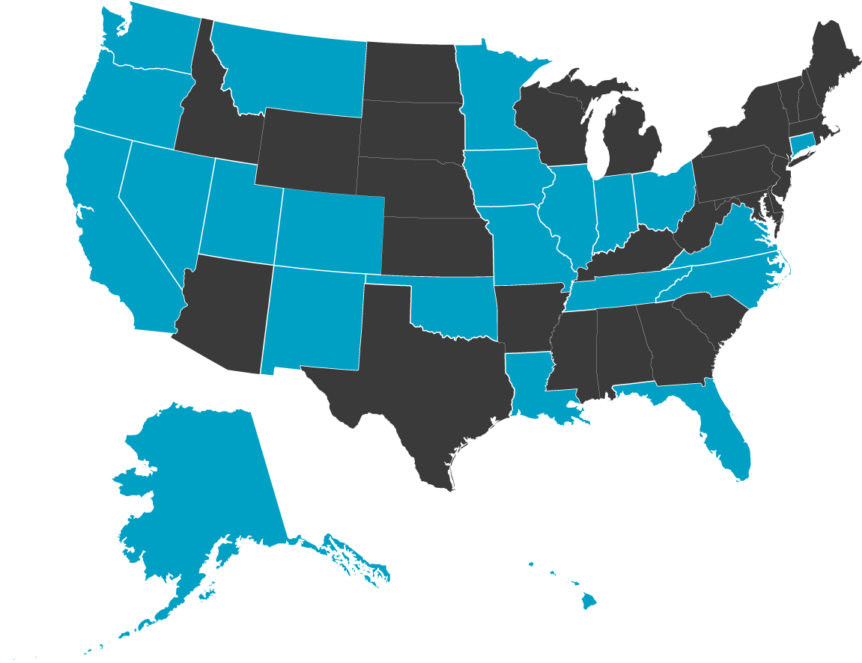
Listening Sessions Distribution
Notes:
Procedures
20 Facilitators conducted listening sessions across the country
Listening sessions were conducted in urban, rural, suburban and tribal communities with staff, parents/caregiver and girls :
Northeast
Southeast
South
Midwest
Northwest
Southwest
West
Locations within these regions were selected using the following key indicators:
High poverty
Foreign born
Rural households
Infant death rate
High school dropout
Child victimization
Children in foster care
Adult crime
High proportion of girls’ incarceration

Slide 4
Voices from the Field
Recommendations
  Establish an information clearinghouse
  Address “silo-ing” across child welfare, public & mental health, education, recreation, etc.
  Involve schools, families, and gatekeepers in raising awareness & provide specialized training
  Include voices of parents/caregivers and girls in research & theory building about what works
  Develop standards of care to guide programming
Notes:
The complete Voices from the Field: NGI Listening Session Report and Executive Summary has been provided in the Member’s materials.
Provide a clearinghouse of information that is responsive to these unique and universal needs
Address the silos of child welfare, education, mental health, public health, recreation, etc.
Involve schools, families, and gatekeepers in awareness efforts and provide specialized training for these groups
Include the voices of parents/caregivers and girls in the research and theory building about what works for girls
Develop standards of care to guide programming
4

Slide 5
Voices from the Field
Recommendations
  Provide pilot funding for family-focused interventions
  Fund training that includes parents, girls & professionals and enhances sustainability for states, jurisdictions
  Track the profile of girls entering the JJ system & monitor over time
  Identify effective strategies to engage families/caregivers in treatment
  Research impact of social media on girls’ JJ involvement
  Evaluate how to streamline/coordinate policies & practices across systems -- while maintaining confidentiality
Notes:
Provide funding for piloting of family-focused interventions
Provide funding for piloting of training models that include parents, girls, and professionals and create a format for states and jurisdictions/long-term sustainability
Conduct research to track the profile of girls entering the juvenile justice system and monitor changes over time
Research effective strategies to engage mothers/families/caregivers in the day-to-day treatment milieu
Conduct research to increase understanding of the impact of social media and girls’ involvement in the juvenile justice system
Evaluate policies and practices across agencies and systems that can be streamlined while maintaining confidentiality
5

