Slide 1

4-H PYD and the
OJJDP Collaboration
Coordinating Council on Juvenile
Justice and Delinquency Prevention
September 19, 2024
Bonita Williams, Ph.D.
National Program Leader
Division of Youth and 4-H

Slide 2


Purpose Today

Slide 3

What do the four Hs stand for?

Slide 4

4-H Pledge
I pledge my Head to clearer thinking
My Heart to greater loyalty
My Hands to larger service
And My Health to better living
For my Club, my Community, my Country and my World!
Notes:
Title, content & image

Slide 5

USDA/NIFA
4-H is USDA’s flagship positive youth development and education program.
USDA NIFA is responsible for the organization, supervision and administration of the 4-H program at the federal level.
4-H is administered through the Division of Youth and 4-H in NIFA’s Institute of Youth, Family and Community.
Notes:
Title & 2 column content.

Slide 6
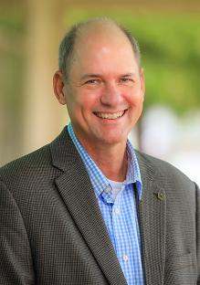

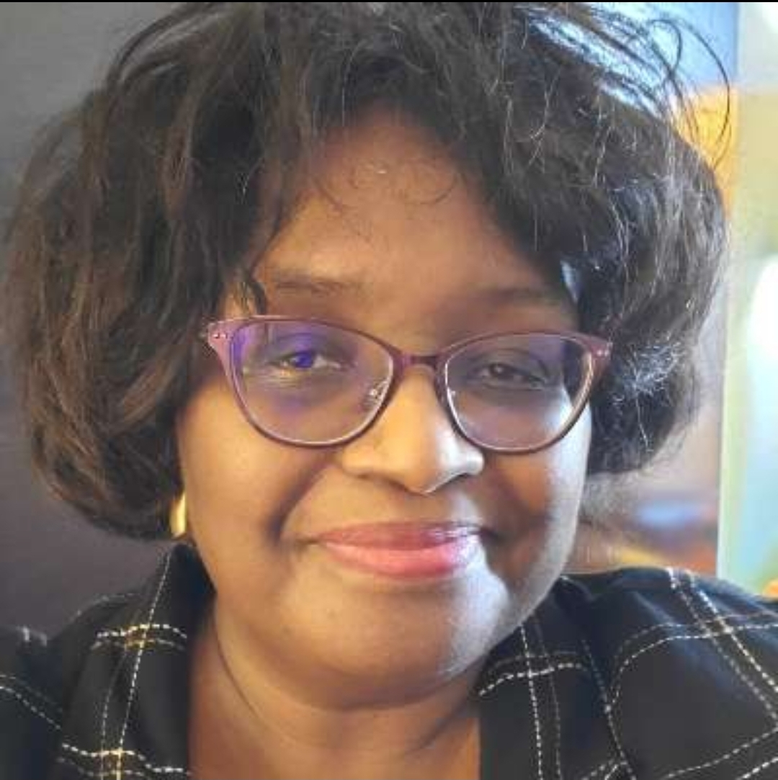
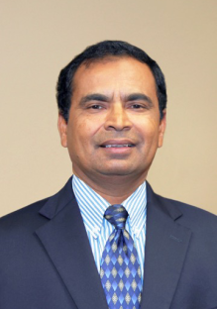



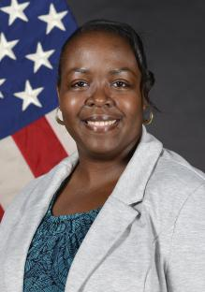
DY4-H Team
NATIONAL PROGRAM LEADERS
DIVISION DIRECTOR
Jeff Sallee, PhD
Maurice Smith, PhD
Bonita Williams, PhD
PROGRAM ASSISTANT
Manoharan Muthusamy, PhD
Shelly-Bright
Manga
Chris Petty
Andrea Wikiera
Akelia Lewis
Notes:
Title & 2 column content.

Slide 7



What is the 4-H Program?
CONDUCTED AT THE STATE AND LOCAL LEVEL,
4-H REACHES MORE THAN
6 M YOUTH
4-H has a rich history of being a leader in positive youth development experiences for more than a century.
4-H is the youth outreach program of the USDA. Implemented by the Cooperative Extension System through over 110 LAND-GRANT COLLEGES AND UNIVERSITIES across the United States and its territories.
2.6M RURAL
1.8M URBAN
1.6M SUBURBAN
DELIVERED BY 3,500 COOPERATIVE EXTENSION PROFESSIONALS
500,000 TRAINED VOLUNTEERS
Notes:
4-H has a rich history of being a leader in positive youth development experiences for more than a century is and is implemented by the Cooperative Extension System through the LGU system. The program reaches more than 6 million youth across the United States and its territories.

Slide 8
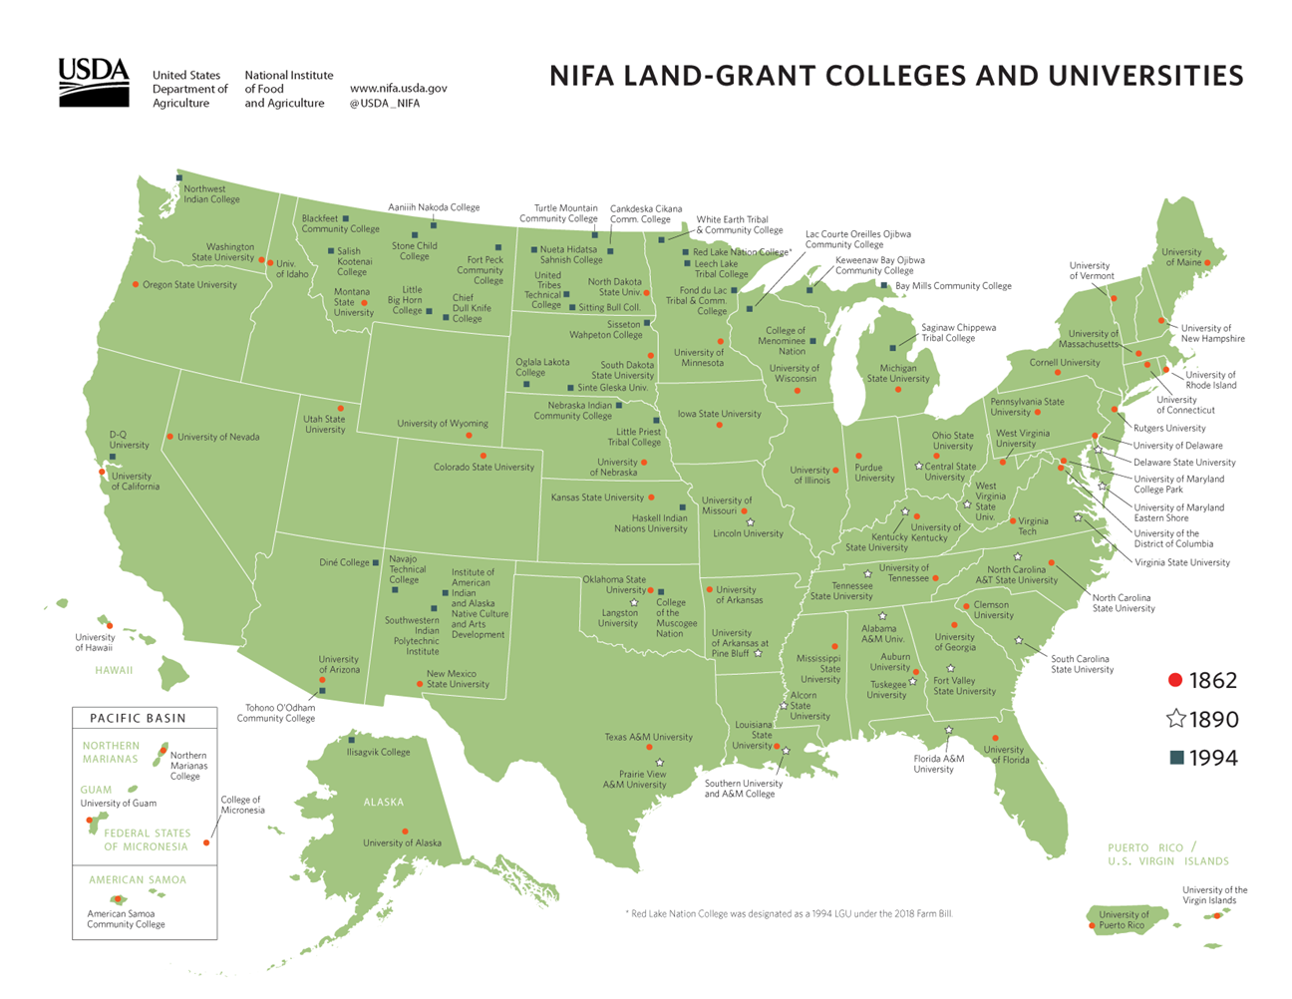
4-H System
NIFA
National 4-H Council (Foundation)
Cooperative Extension Service – 110+ LGUs
  Ag – FCS – Rural Development – 4-H
  3143 Counties
  Funding is Cooperative
  Federal – State – Local
  1 or more educators per county
  4-H is dependent on Volunteers
Notes:
Besides NIFA, 4-H has two other National Partners, National 4-H Council and the Cooperative Extension service
CES focuses on four programs in most counties; Ag, Family and Consumer Sciences, Rural/Community Development, and 4-H Youth Development.
This takes place in 3143 Counties across the nation
Funding is Cooperative, split between Federal, State, and Local resources
There are typically one or more educators per county
But it doesn’t stop there, 4-H and CES is dependent on its VOLUNTEER programs

Slide 9
4-H and Member Definition
“All youth programming in Extension is by definition 4-H and that the preferred name for Extension Youth Development Programming is 4-H Youth Development”. - ECOP, March 2018
“A 4-H Member is a youth who participates in any educational program or activity delivered by Cooperative Extension and/or receives Cooperative Extension-based curriculum. 4-H Member includes a youth who is ‘Individually Enrolled’ or ‘Group Enrolled’, regardless of the type of 4-H engagement/delivery method in which they are participating”. - PLWG, June 2019
Notes:
Nationally, a lot of attention has been directed toward defining what is considered 4-H and what a 4-H member is. These are meant to be inclusive of all youth programs and young people that participate in them. The reason for these national definitions is that sometimes LGUs use restrictive definitions and criteria that create barriers and may even lead to discrimination.
While these definitions have been adopted nationally LGU definitions likely vary.
Read definitions..
Individual enrollment vs group enrollment… This is another distinction that is important to understand in terms of the definitions used by the LGU.
In some cases – Individual = they have individual information on the youth (contact information, parental/guardians information, appropriate releases signed, etc.) and for group they do not (e.g., youth at an activity where they are not registered because not possible or more commonly a school or other “group” setting). In some cases – it may determine who pays membership dues, who has liability/accident/sickness coverage. In other cases the LGU covers both individual and group.
4-H Community Club youth are always individually enrolled!
And, it may be that only those who are individually enrolled are considered 4-H members and have access to events and/or the only once who have access to information about such things.
It may also distinguish those under the responsibility of the University (individual) versus those who are not (group).

Slide 10

The Collaboration
Develop a program to expand opportunities for
Rural youth,
Juvenile Justice Involved Youth,
Youth at risk of juvenile justice involvement to receive mentoring services through 4-H programming.
Notes:
Title & 2 column content.

Slide 11
Keisha Kersey
IAA
5 Years
3 Years
$2M
Keisha Kersey
Senior Grants Management Specialist
Delinquency Prevention and Child Protection Division
Office of Juvenile Justice and Delinquency Prevention
Notes:
Quote or information slide

Slide 12
MARRY
Mentoring at Risk and Rural Youth
Alignment with USDA’s Strategic Plan FY 2022-2026
Goal 5: Expand Opportunities for Economic Development and Improve Quality of Life in Rural and Tribal Communities.
Notes:
Title and content

Slide 13
Critical Components
1. Evidence-based Projects
2. Juvenile Justice-Involved Youth
3. Rural Youth
4. Youth At-risk of Juvenile Justice Involvement
5. Mentoring Services
6. National Mentoring Resource Center (NMRC)

Slide 14
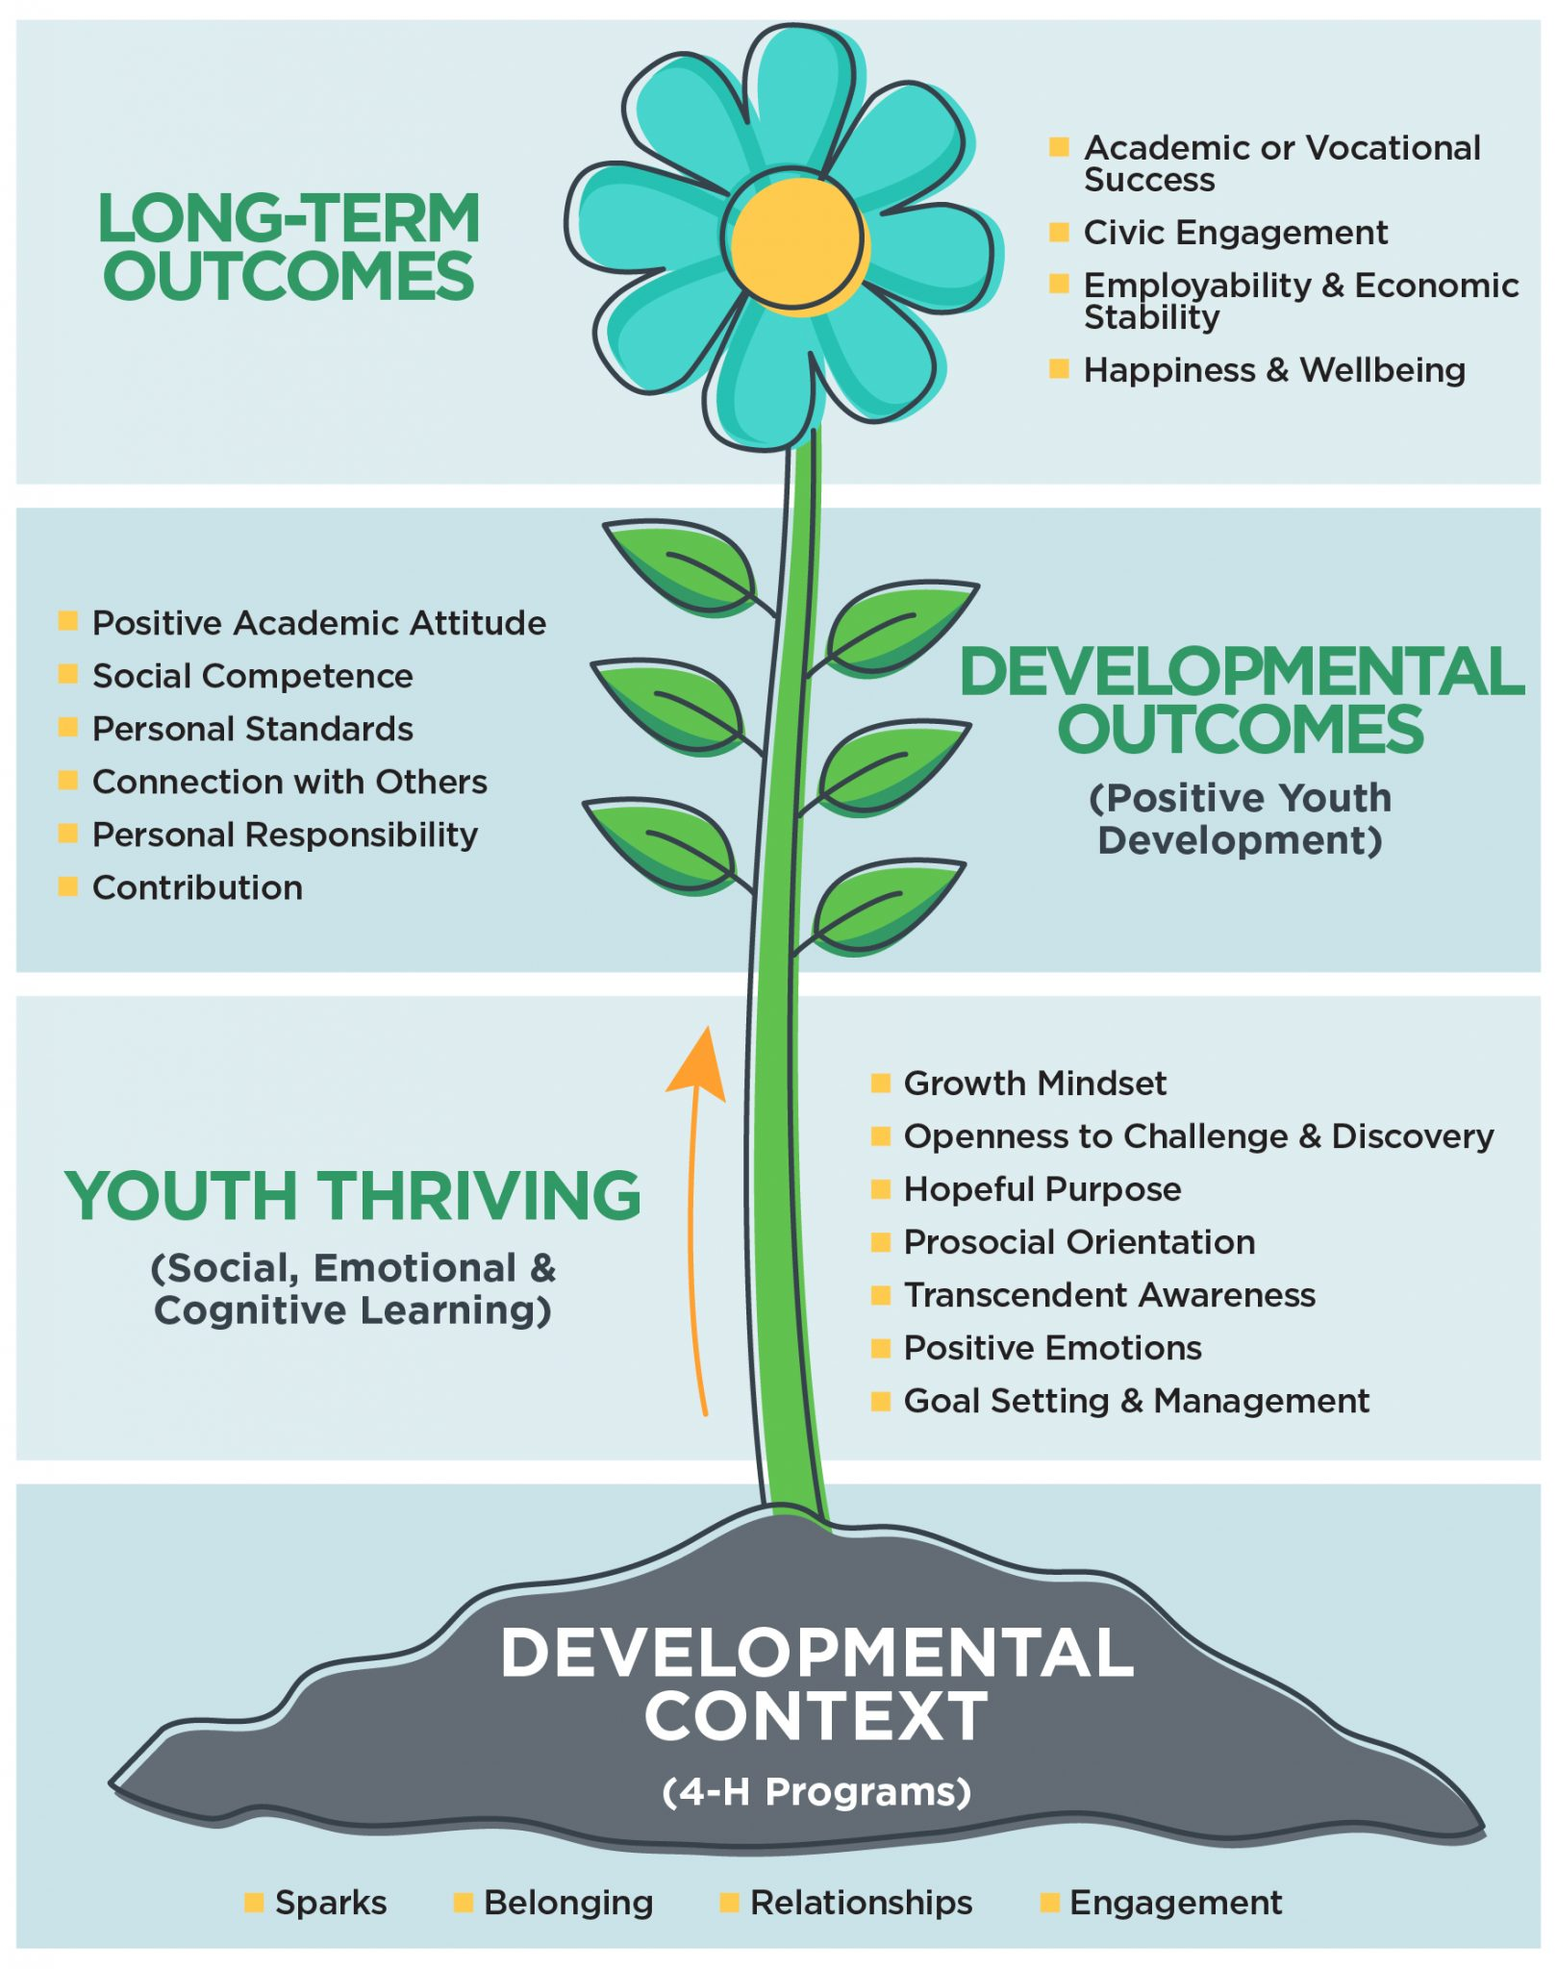

Developmental Context
Notes:
4-H Education is research based, including the methods used for educating youth. The Thrive model is the positive youth development model developed by Extension researchers for 4-H youth development.

Slide 15
Competitive RFA

Slide 16






Six Grantees
Ohio Pathways for Appalachian Youth Success
(PAYS)
Utah 4-H Mentoring For Rural At-Risk Youth
Maine NorthStar 4-H Youth Mentorship Project
Mentoring Essex County, NY Youth With the 4-H Thrive Model
WVU Extension MARRY Program
Beyond Ready: Empowering Indiana’s Youth Through Career Discovery Mentors
Notes:
Title & 3 column content with images.
Edit Master Slide if needed.

Slide 17
OJJDP
Continuum of Care
For Communities
Prevention
5
Intervention –Low
1

Slide 18
Anticipated Engagement/Outcomes
Youth and Family Partnerships
Monthly Structured Mentoring Activities
400 mentored youth
Youth grades 4-12
1:1 and group mentoring
Youth at-risk of juvenile justice involvement
Rural economically disadvantaged youth
Youth already involved with the juvenile justice system
Skill development
Community inclusion
Increased self-concept
Career readiness
Improved Communication
Building technology skills
Increase protective factors against negative social messages
Notes:
Title, content & image collage.

Slide 19
Non-Discrimination Statement
https://www.usda.gov/non-discrimination-statement
In accordance with federal civil rights law and U.S. Department of Agriculture (USDA) civil rights regulations and policies, the USDA, its Agencies, offices, and employees, and institutions participating in or administering USDA programs, are prohibited from discriminating based on race, color, national origin, religion, sex, gender identity (including gender expression), sexual orientation, disability, age, marital status, family/parental status, income derived from a public assistance program, political beliefs, or reprisal or retaliation for prior civil rights activity, in any program or activity conducted or funded by USDA (not all bases apply to all programs). Remedies and complaint filing deadlines vary by program or incident.
Persons with disabilities who require alternative means of communication for program information (e.g., Braille, large print, audiotape, American Sign Language, etc.) should contact the responsible agency or USDA’s TARGET Center at (202) 720-2600 (voice and TTY) or contact USDA through the Federal Relay Service at (800) 877-8339. Additionally, program information may be made available in languages other than English.
To file a program discrimination complaint, complete the USDA Program Discrimination Complaint Form, AD-3027, found online at How to File a Program Discrimination Complaint and at any USDA office or write a letter addressed to USDA and provide in the letter all of the information requested in the form. To request a copy of the complaint form, call (866) 632-9992. Submit your completed form or letter to USDA by: (1) mail: U.S. Department of Agriculture, Office of the Assistant Secretary for Civil Rights, 1400 Independence Avenue, SW, Washington, D.C. 20250-9410; (2) fax (202) 690-7442; or (3) email: program.intake@usda.gov.
USDA is an equal opportunity provider, employer and lender.
Notes:
REQUIRED SLIDE FOR ALL EXTERNAL PRESENTATIONS. DO NOT REMOVE FROM YOUR PRESENTATION.
It is acceptable to summarize this statement verbally while displaying it, by reading the first bullet point in its entirety, and stating that the slide contains contact information for individuals with disabilities to request reasonable accommodations, that language access services will be provided to limited English proficient individuals upon request, and that anyone wishing to file a complaint can utilize the phone number, fax number, or postal mailing address listed on the slide.

Slide 20
Questions?

