Slide 1
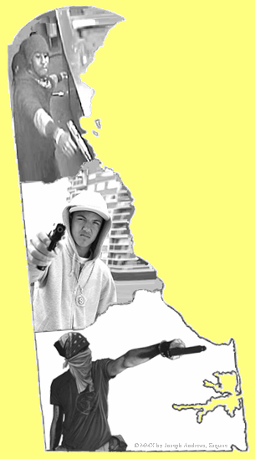
Delaware’s Gun Court
Chandlee Johnson Kuhn
Chief Judge
Delaware Family Court

Slide 2
Every single day in the United States, guns cause the death of 20 children and young adults.
Children and young adults constitute over 41% of all firearm deaths and non-fatal injuries.
“Gun Violence Statistics,” Legal Community Against Violence http://www.lcav.org/statistics-polling/gun_violence_statistics.asp#9.

Slide 3
Why have Gun Court?

Slide 4
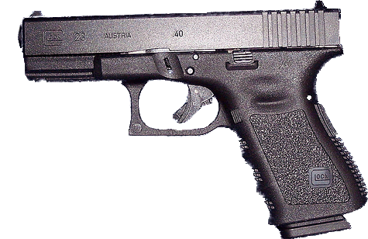
The Need
Juvenile “street gun culture” trend
  20% of all perpetrators of Wilmington gun crime in 2008 were juveniles between the ages of 14 and 16
System complications:
  Dual jurisdiction of Family Court & Superior Court
  Crowded court calendars
  Multiple case delays
  No communications between various State agencies
  Inadequate data tracking & information sharing
  Political bickering

Slide 5
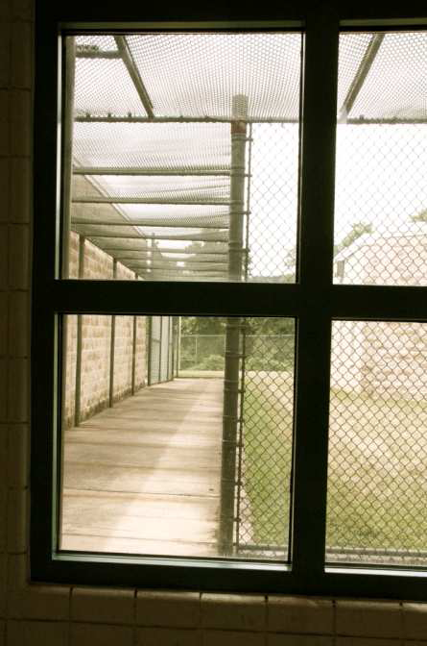
The Solution
Establish a Gun Court
  2009
  Part of Family Court
  Exclusively for juveniles
GOAL:
  To break the repeating cycle of juvenile gun crime & rehabilitate DE’s youth as quickly & effectively as possible within Constitutional Rights.

Slide 6
Methodology
Delaware is looking at each individual juvenile and assessing their unique individual circumstances
Emphasizing treatment and education over punishment and alienation has led to a low recidivism rate and judicial and economical efficiency.
The collaboration among the Court, Prosecutor’s Office, Defense Counsel and the Division of Youth Rehabilitative Services has made this program successful in Delaware.

Slide 7
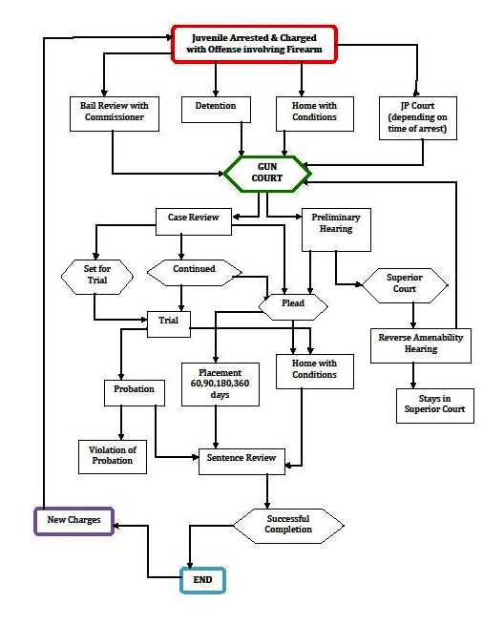

Slide 8
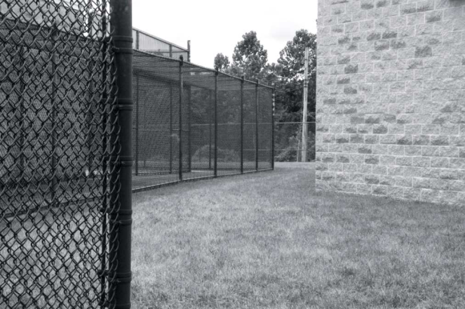
The Reasoning
Addressing gun violence in juvenile court promotes community safety and rehabilitation
Single, streamlined forum to address gun violence
Sentences include appropriate treatment, rehabilitation efforts & close court supervision
Consistent data tracking for effective resource allocation

Slide 9
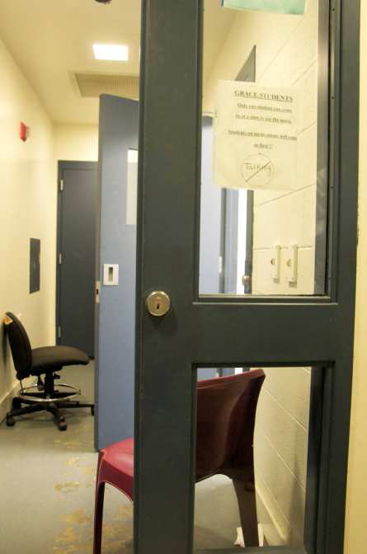
The Upside
By keeping juveniles incarcerated, more of them are completing high school & receiving their GEDs, when they previously never did.

Slide 10
The Downside
Taking a risk with these youths in terms of giving them another chance after committing very serious offenses
Gun Court calendar will eventually be overloaded with non-gun cases since once in Gun Court, juvenile comes back for all subsequent charges.

Slide 11


Dwayne Betts
What is the value of a life?

Slide 12
Success Story
New Castle County: E. G.
  Came in with very serious robbery gun charges
  Went to Project Stay-Free
  Committed a VOP by failing to check in
  First 90 days → no change
  Today (6 months later): a New man.
  Packed the Courtroom with supporters
  Thankful for the second chance

Slide 13
Delaware Gun Court Statistics

Slide 14
Statistics
One year after inception, Delaware’s Gun Court decreased the number of juvenile gun cases heard in Superior Court by 44%.
Drastically reduced case disposition time
  Nearly 90% of cases plead.
Reduced expenses: 61% of the space at DE’s juvenile detention centers was occupied by gun crime defendants in 2008. In 2009 Gun Court reduced this to 17%.
As of January 2012, out of the 230 juveniles who had come through Gun Court, 35 had new gun charges.
  15% recidivism rate

Slide 15
Total Violent Felonies by County

Slide 16
Violent Felony Recidivism Rate
2009
2010
2011

Slide 17
Average Recidivism Rate 09-11

Slide 18
The Gun Court Process
From Arrest through Release

Slide 19
The Process: Arrest
Arrest
After Hours
JP Court
Business Hours
Family Court
Immediate Treatment
Immediate Treatment

Slide 20
The Process: Charges
Superior Court Jurisdiction
Superior Court Jurisdiction if 16 and Older
Family Court Jurisdiction
Superior Court
  First and Second-Degree Murder
  First and Second-Degree Unlawful Sexual Intercourse
  First Degree Assault
  First Degree Kidnapping
  First Degree Robbery IF
      Previously adjudicated delinquent of 1 or more offenses which would constitute a felony AND
      Involves a deadly weapon OR involves the threat of possessing a deadly weapon OR involves the infliction of serious physical injury on the victim

Slide 21
The Process: Charges
Superior Court Jurisdiction
Superior Court Jurisdiction if 16 and Older
Family Court Jurisdiction
Superior Court
  If Defendant is 16 or older AND has previously been found delinquent of a felony AND the current charge is
    First-Degree Conspiracy
    First-Degree Arson
    First-Degree Burglary
    An attempt of any of these charges

Slide 22
The Process: Charges
Superior Court Jurisdiction
Superior Court Jurisdiction if 16 and Older
Family Court Jurisdiction
Gun Court
  An amenability hearing will be held if:
    Juvenile is 16 or older
    Charged with
      Manslaughter
      First-Degree Burglary
      Arson
      Second-Degree Rape
      An attempt of any of these charges
  Otherwise, Gun Court has Jurisdiction

Slide 23
The Process: Charges
Superior Court Jurisdiction
Superior Court Jurisdiction if 16 and Older
Family Court Jurisdiction
Typical Gun Court Charges
  Carrying a Concealed Deadly Weapon
  Possession of a Firearm During the Commission of a Felony
  Reckless Endangering
  Aggravated Menacing
  Theft of a Firearm
  Possession of a Weapon in a Safe Zone

Slide 24
The Process: Amenability
Attorney General’s Office
Makes decision about Amenability
Defendant
Can Accept or ask for hearing
Judge
Final Decision

Slide 25
The Process: Amenability
Judge will incorporate the opinions of the:
Prosecutor
Public Defender
Defendant
Psycho-Forensic Evaluator
YRS

Slide 26
The Process: Amenability
Judge will incorporate the following factors
Age of defendant
Prior Record
Recommendations
Defendant’s Home Life
Defendant’s Mental Health Issues
Whether defendant was in Foster Care

Slide 27
The Process: Prelim
Gun Court Judge hears Preliminary Hearings for all cases in Gun Court, even those which will be transferred to Superior Court.
Gun Court
Gun Court
Preliminary Hearing
Subsequent Proceedings
Superior Court

Slide 28
The Process: Case Review
Prior to going to trial, a case review is scheduled.
Case Review
Includes Prosecutor, Defense Attorney, Defendant, and Gun Court Judge.
Plea Offer
If rejected, case goes to trial in front of different Family Court Judge.
Prosecutor may not follow the case, but the Public Defender may.

Slide 29
The Process: Sentencing
Judge has discretion over where to place defendant.
Incorporates opinions of:
Prosecutor
Public Defender
Defendant
Psycho-Forensic Evaluator
YRS

Slide 30
The Process: Sentencing
Criminal History
Prior Placements
The specific goals of the placement facilities
Defendant’s mental illness / depression
Defendant’s history of violence
Defendant’s prescribed medication
Defendant’s substance abuse issues
Incarceration
Treatment
Factors that should be considered in placement decision:

Slide 31

The Process: Placements
Grace Cottage
Glen Mills (Pennsylvania)
Coastal Harbor (Georgia)
Project Stay-Free
Ferris
South Dakota & Southwest Indiana (Girls)

Slide 32
The Process: Sentence Reviews
Held periodically in front of Gun Court Judge
On phone or in person
Department of Services for Children, Youth, and their Families conducts probation reviews and status updates
Treatment Facility
Probation Officer
Gun Court Judge
Sentence Review

Slide 33
The Process: The End
Arrest
Plea
Sentence
Completion
New Charges
Juvenile completes sentence, gun court jurisdiction ends.
BUT, subsequent charges will bring the defendant back to Gun Court, whether or not the new charges involve a weapon.

Slide 34
The Role of Gun Court Players

Slide 35
Roles: Judge
Gun Court Judge presides over:
Arraignments
Preliminary Hearings
Case Reviews
Amenability Hearings
Pleas & Sentencing
Bail Reviews

Slide 36
Roles: Judge
Has the choice to:
Waive Jurisdiction
Find Non-Amenable
Accept Plea
Set a Date for Trial
Continue

Slide 37
Roles: Prosecution
Defendant’s Age
Prior Record
Seriousness of Offense
Any Family Court Benefit
D’s Prior Placement History
Evaluates, based on the nature of the crimes, whether jurisdiction lies in Superior Court or Family Court.
Statutory mainly, but will also look at factors:

Slide 38
Roles: Prosecution
Defendant’s Age
Prior Record
Seriousness of Offense
Any Family Court Benefit
D’s Prior Placement History
Prior to Trial:
  Accumulates as much information as possible
  Talks with Defense Attorney, Child Services and Support Services
    Gets to hear mitigating factors

Slide 39
Roles: Prosecution
Maintain public safety
without
Ruining the defendant’s Life
Goal:

Slide 40
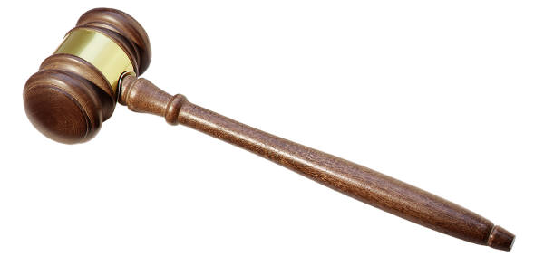
Roles: Defense
Meet with Defendant, PFE, Family
Goal: Keep the case in Gun Court, and out of the Superior Court.

Slide 41
Roles: Defense
To keep the case in Gun Court, argue mitigating factors.
If staying in Gun Court, conduct discovery after preliminary hearing.
Defendant
Support Services
YRS
Family Members

Slide 42
Roles: Youth Rehabilitative Services
Home Behavior
Substance Abuse
Mental Health
School Records
Prior to hearing, probation officers attempt to reach out to defendant’s on Gun Court Calendar.
Explain their role in Gun Court.
Try to collect records:

Slide 43

Roles: Youth Rehabilitative Services
Reach out to pre-trial programs
Learn Min. Mandatory
Recommend to Court
Meet with family and defendant
Coordinate with other divisions

Slide 44
Roles: Support Services
Delaware Public Defender’s Office established the first Psycho-Forensic Evaluator (PFE) Unit of any PDO in 1980.
Masters-level PFEs assist attorneys
Client History
Medical
Develop Client Specific Plan
Alternatives to Level 5
Provide Mitigating Factors at Sentencing
Mental-Health
Substance Abuse
For Conditional Pre-Release
Assist Attorneys
In hiring Experts
Defenses

Slide 45

Roles: Support Services
PFEs try to get the complete picture of the defendant.
Contact all parties in defendant’s life
Assist Attorneys

Slide 46
Future Goals
Lower recidivism rates.
Provide more juvenile’s with access to education/ GED programs.
Help juveniles become employed or employable upon completion of rehabilitative treatment.
Gain a better understanding of the reasons for youth gun crimes.

Slide 47
Conclusion
Gun Court is still a work in progress, but we have seen positive results thus far and we continue to adapt to better serve the citizens of Delaware.

Slide 48
Questions?

